Slide 1

#LifeKoKaroLift
Post-Graduate Diploma in ML/AI

Slide 2



Course : Machine Learning
Lecture On : Random Forest
Instructor : Aditya Bhattacharya

Slide 3
Modules Included
Recap of Decision Trees
Ensemble Learning
Boosting and Bagging
Random Forest
Code Example

Slide 4
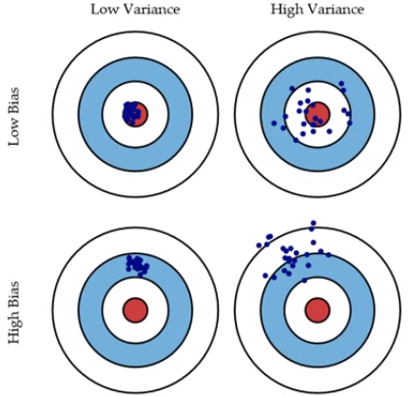
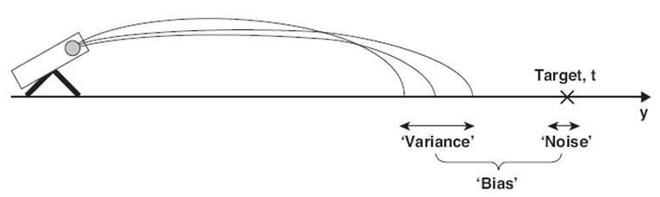
Recap: Bias and Variance
The prediction error for any machine learning algorithm can be broken down into three parts:
Bias Error
Variance Error
Irreducible Error
The irreducible error cannot be reduced regardless of what algorithm is used. It is the error introduced from the chosen framing of the problem and may be caused by factors like unknown variables that influence the mapping of the input variables to the output variable.

Slide 5

Ensemble methods
Ensemble learning is a machine learning paradigm where multiple models (often called “weak learners”) are trained to solve the same problem and combined to get better results.
https://towardsdatascience.com/ensemble-methods-bagging-boosting-and-stacking-c9214a10a205

Slide 6


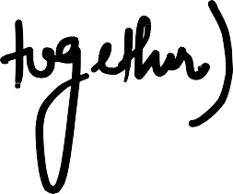




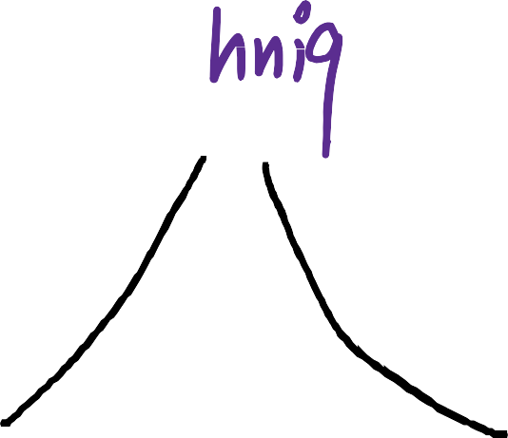




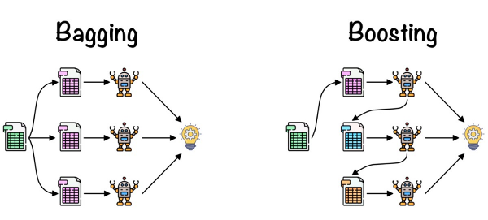
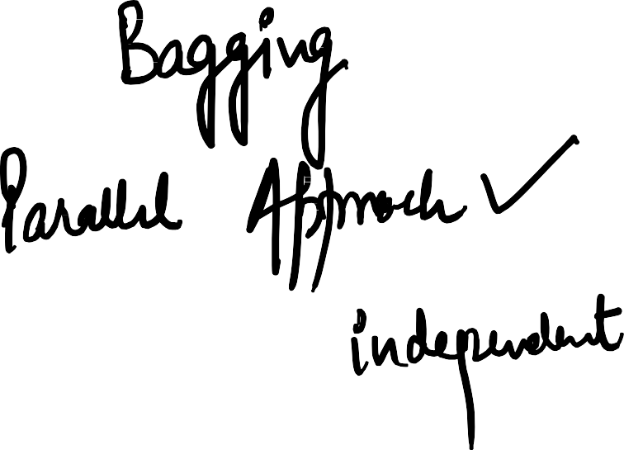
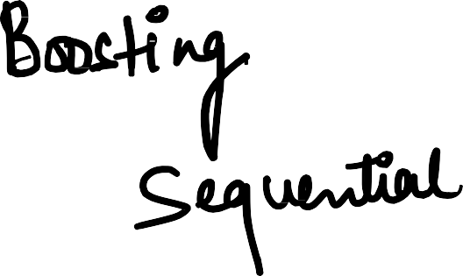
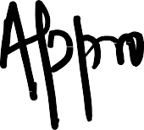



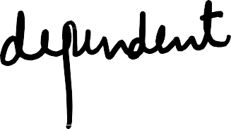
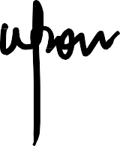










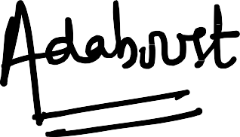

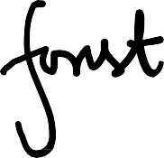



Slide 7
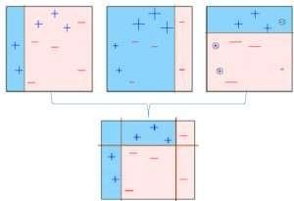

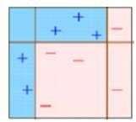

Boosting
The observations which are incorrectly predicted, are given higher weights and an another model is created and
Base model is
created on asubset
. The individual models would not perform well on the entiredataset, but they work well for some part of the dataset. Thus, each model actually boosts the performance of the ensemble.
predictions aremade on the dataset
multiplemodels are created, each correcting the errors of the previousmodel.
The final model (strong learner)
Boosting, that often considers homogeneous weak learners, learns them sequentially in a very adaptive way (a base model depends on the previous ones) and combines them following a deterministic strategy
https://medium.com/mlreview/gradient-boosting-from-scratch-1e317ae4587d

Slide 8
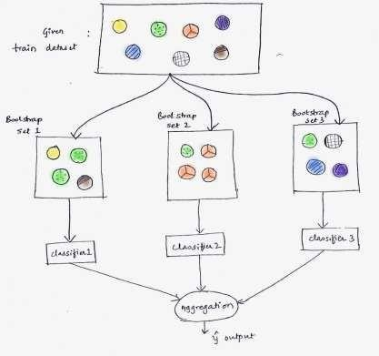
Bagging
Bagging, that often considers homogeneous weak learners, learns them independently from each other in parallel and combines them following some kind of deterministic averaging process
https://learn.upgrad.com/v/course/515/session/77070/segment/431269

Slide 9
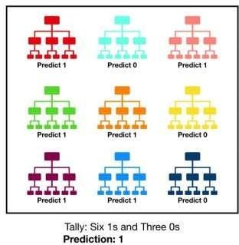
Random Forest
Random forest, like its name implies, consists of a large number of individual decision trees that operate as
an ensemble. Each individual tree in the random forest spits out a class prediction and the class with the most votes becomes
our model’s prediction
The reason for this wonderful effect is that the trees protect each other from their individual errors (as long as they don’t constantly all err in the same direction)

Slide 10
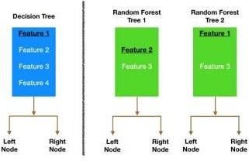
Random Forest
Bagging (Bootstrap Aggregation) — Decision trees are very sensitive to the data they are trained on — small changes to the training set can result in significantly different tree structures. Random forest takes advantage of this by allowing each individual tree to randomly sample from the dataset with replacement, resulting in different trees.
Feature Randomness — In a normal decision tree, while splitting a node, we consider all the features and pick the one that produces the most separation. In contrast, each tree in a random forest can pick only from a random subset of features. This forces even more variation amongst the trees in the model and ultimately results in lower correlation across trees and more diversification.

Slide 11
Key features of Random Forest
Diversity: Not all attributes/variables/features are considered while making an individual tree; each tree is different.
Immune to the curse of dimensionality: Since each tree does not consider all the features, the feature space is reduced.
Parallelization: Each tree is created independently out of different data and attributes. This means we can fully use the CPU to build random forests.
Stability: Stability arises because the result is based on majority voting/ averaging

Slide 12
Benefits of Random Forest
Reduced risk of overfitting: Decision trees run the risk of overfitting as they tend to tightly fit all the samples within training data. However, when there’s a robust number of decision trees in a random forest, the classifier won’t overfit the model since the averaging of uncorrelated trees lowers the overall variance and prediction error.
Provides flexibility: Since random forest can handle both regression and classification tasks with a high degree of accuracy, it is a popular method among data scientists. Feature bagging also makes the random forest classifier an effective tool for estimating missing values, as it maintains accuracy when a portion of the data is missing.
Easy to determine feature importance: Random forest makes it easy to evaluate variable importance, or contribution, to the model. There are a few ways to evaluate feature importance. Permutation importance, also known as mean decrease accuracy (MDA) identifies the average decrease in accuracy by randomly permutating the feature values in OOB samples.

Slide 13
Challenges of Random Forest
Time-consuming process: Since random forest algorithms can handle large data sets, they can be provide more accurate predictions, but can be slow to process data as they are computing data for each individual decision tree.
Requires more resources: Since random forests process larger data sets, they’ll require more resources to store that data.
More complex: The prediction of a single decision tree is easier to interpret when compared to a forest of them.

Slide 14
Hyperparameters of Random Forest
For predictive power
n_estimators: Number of trees the algorithm builds before averaging the predictions.
max_features: Maximum number of features random forest considers splitting a node.
mini_sample_leaf: Determines the minimum number of leaves required to split an internal node.
criterion: How to split the node in each tree? (Entropy/Gini impurity/Log Loss)
max_leaf_nodes: Maximum leaf nodes in each tree
For speed of execution
n_jobs: it tells the engine how many processors it is allowed to use. If the value is 1, it can use only one processor, but if the value is -1, there is no limit.
random_state: controls randomness of the sample. The model will always produce the same results if it has a definite value of random state and has been given the same hyperparameters and training data.
oob_score: OOB means out of the bag. It is a random forest cross-validation method. In this, one-third of the sample is not used to train the data; instead used to evaluate its performance. These samples are called out-of-bag samples.

Slide 15
Code Walkthrough

Slide 16

#LifeKoKaroLift
Thank You!

